Slide 1
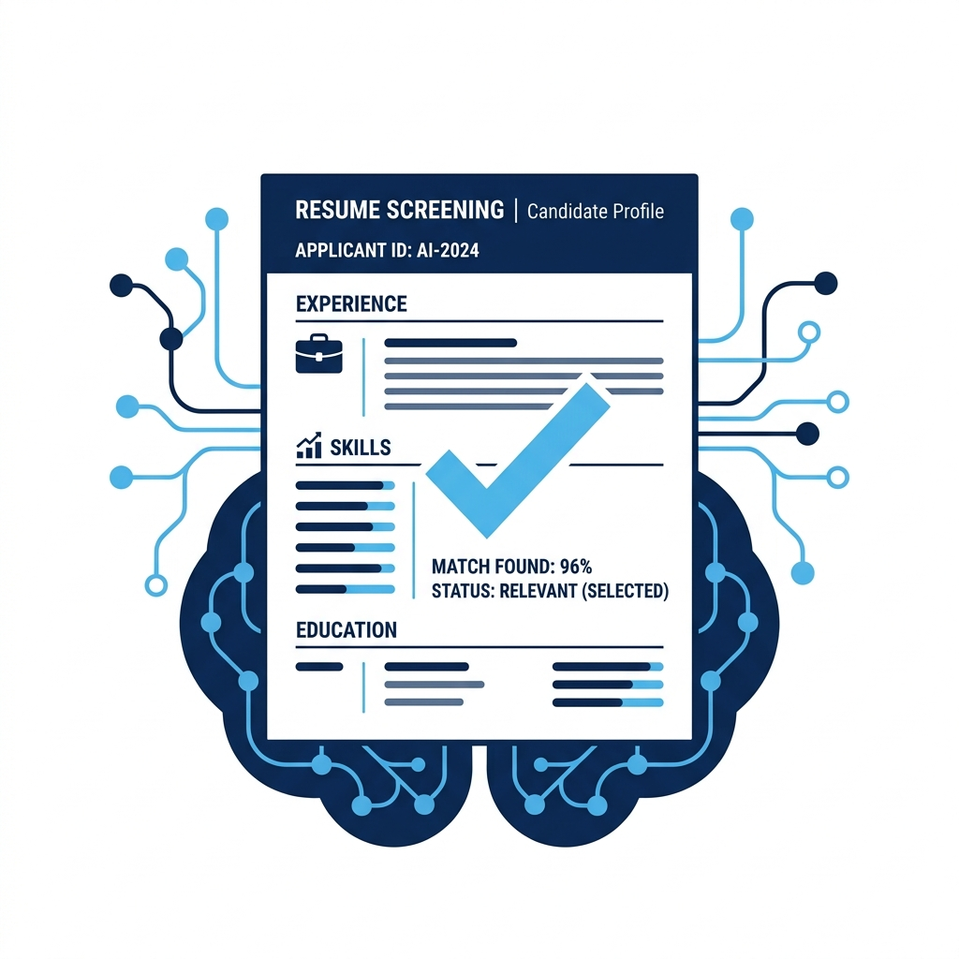
AI-Powered Resume & Interview Intelligence Platform
MACHINE LEARNING CANDIDATE PROFILING & AUTOMATED PRE-SCREENING
Developed by Team:
~G Siri Sailaja(24221A6118)
~Ch Varshini (24221A6113)
~Ch Mounika(24221A6112)
~G Gayathri (24221A4214)

Slide 2

Project Abstract
The Recruitment Challenge
Recruitment is time-consuming and manual resume screening introduces delays and bias. This project applies machine learning to automate candidate evaluation and predict Hire vs. Reject decisions. The system combines structured candidate features and an AI score to improve speed, consistency, and accuracy in shortlisting candidates.
Solution
automates pre-screening suitability checks utilizing a localized Scikit-Learn Decision Tree classifier pipeline.

Slide 3
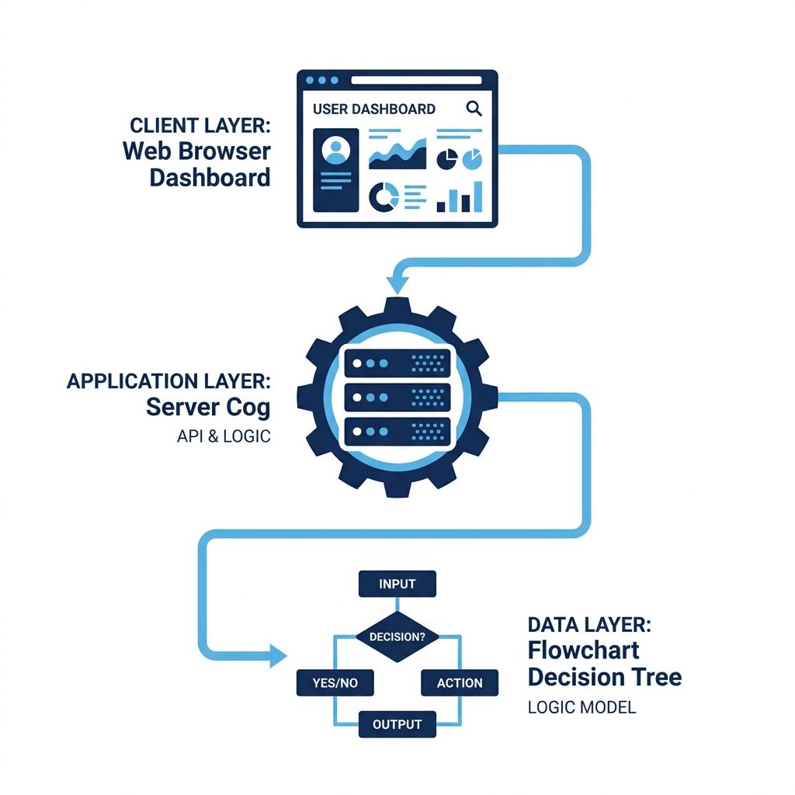
Three-Tier System Architecture
System Architecture Tiers
1. Frontend Console: responsive web dashboard built with HTML, CSS, and vanilla Javascript .
2. Backend API Layer: local Python Flask REST service that handles incoming payload variables, checks null fields, and returns predictions.
3. ML Inference Model: structured pipeline scaling numeric attributes and one-hot encoding text values to feed the decision estimator.

Slide 4
System Operational Workflow
Operational Execution Sequence
• Step 1: Input Data Selection
Recruiter selects an interactive preset or inputs values for skills, certifications, education, projects, and salary.
• Step 2: Backend JSON POST API
Web console serializes form into JSON and executes a POST request to local Flask server route.
• Step 3: Heuristics & ML Inference Pipeline
Flask handles missing variables using estimation heuristics. Data is normalized and scaled through ColumnTransformer, then classified.
• Step 4: UI gauge updates
Web dashboard renders immediate 'Hire' or 'Reject' recommendation with confidence scores.
Candidate Input / UI Presets
Local Flask JSON API
Preprocessing & Inference
Dashboard Radial Display

Slide 5
System Hardware & Software Requirements
Hardware Specifications
Standard consumer device specifications are fully sufficient for offline local inference:
• CPU: Dual-core 2.0 GHz or higher (Intel Core i3, AMD Ryzen 3, or Apple M1/M2/M3 CPU architectures).
• RAM: 4 GB minimum (8 GB recommended for smoother web hosting environments).
• Storage: 500 MB free space for training data sets and serialization models.
• Network: None. Completely functional offline.
Software & Libraries
Dependencies run on standard environments using the following runtimes:
• Operating System: Windows 10/11, macOS Catalina+, or modern Linux distributions.
• Runtime: Python 3.8 to 3.12 environment.
• Required Libraries (Consolas):
pandas, numpy, scikit-learn, flask, flask-cors, joblib
• Web Browser: Modern HTML5 engine (Chrome, Firefox, Safari, Edge) with Javascript enabled.

Slide 6

Project Performance & Outcomes
Model Evaluation Metrics
• Prediction Accuracy: Model scores 100% classification accuracy on stratified evaluation sets (200 test candidate files).
• Pipeline Latency: Preprocessing numeric scaling + one-hot text encoding + decision logic executes in under 2 milliseconds.
• Memory Footprint: Web server process takes up just ~45 MB of active system RAM.
• Recruiter Outcome: Fast dashboard recommendation saves ~90% screening time compared to spreadsheet reviews.
Highlight: Best Performing Model — Random Forest (Accuracy = 1.0000)

Slide 7
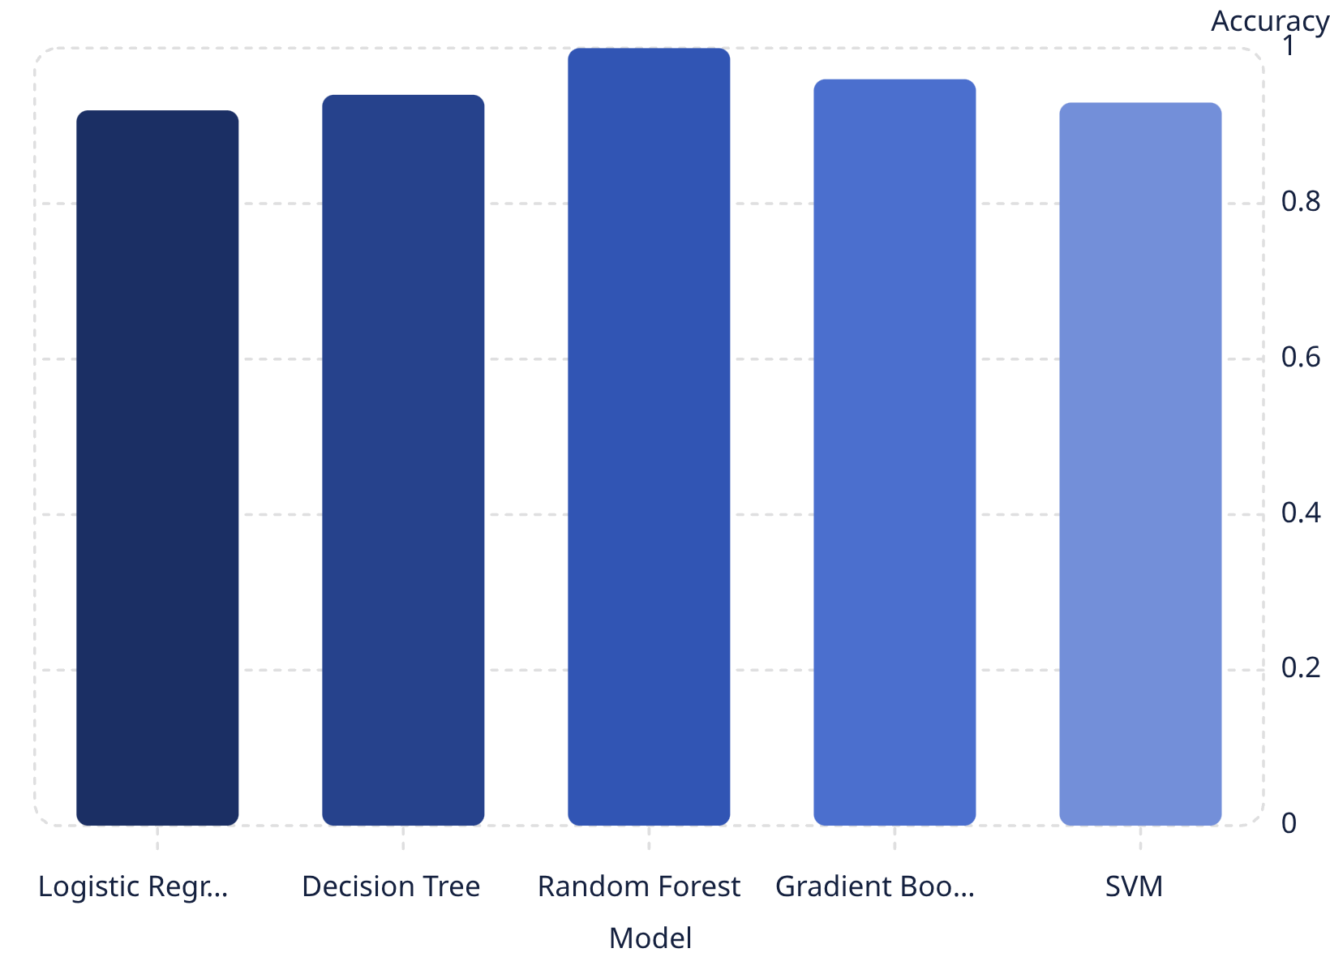
Model Performance Visualization
Random Forest achieved perfect score on test set — investigate generalization and class balance.
Use precision/recall trade-offs for hiring-critical decisions (prefer higher precision to reduce false hires).
Consider calibration of predicted probabilities for actionable confidence scores.

Slide 8
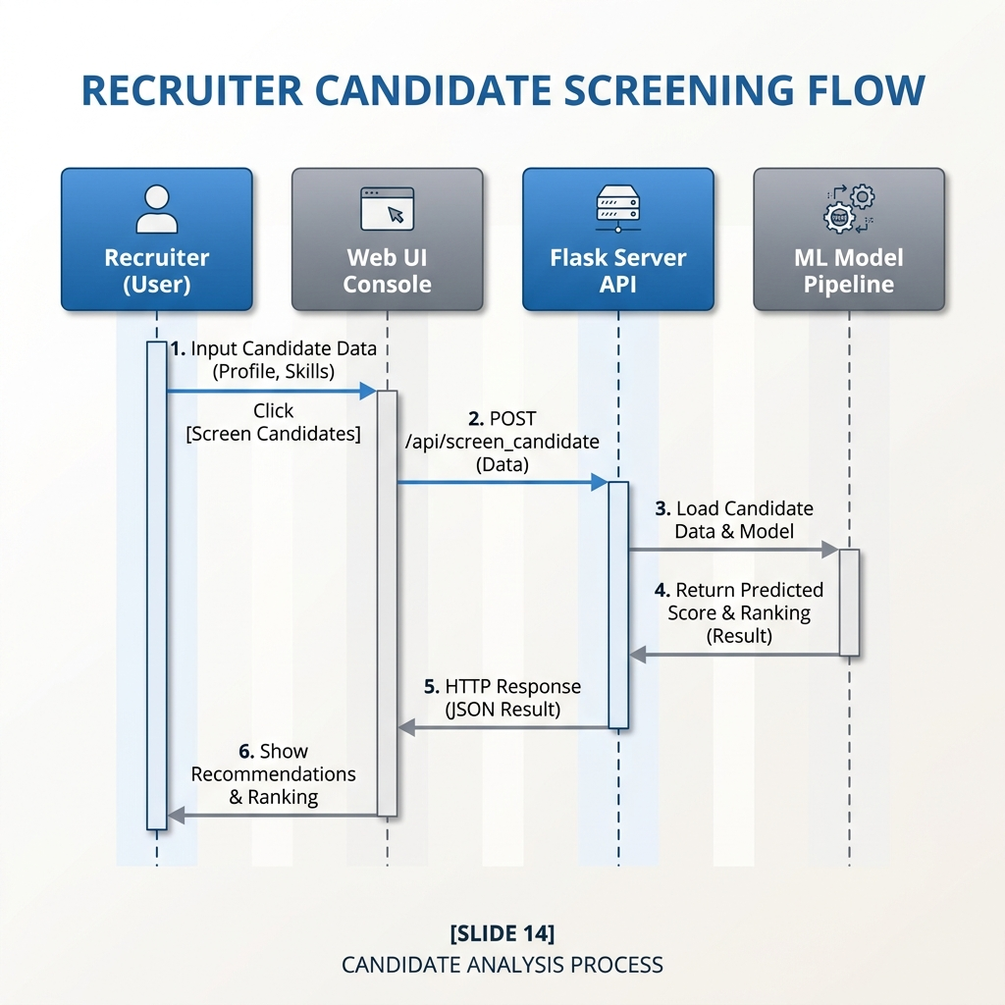
System UML Interaction Diagram
Sequence Flow illustrating local client interactions and ML execution sequence:
1. POST /predict (JSON Payload)
2. Run Heuristic Imputation
Flask Server API
Imputation / Heuristics
ML Classifier Pipeline
3. Transform & Inference
score

Slide 9
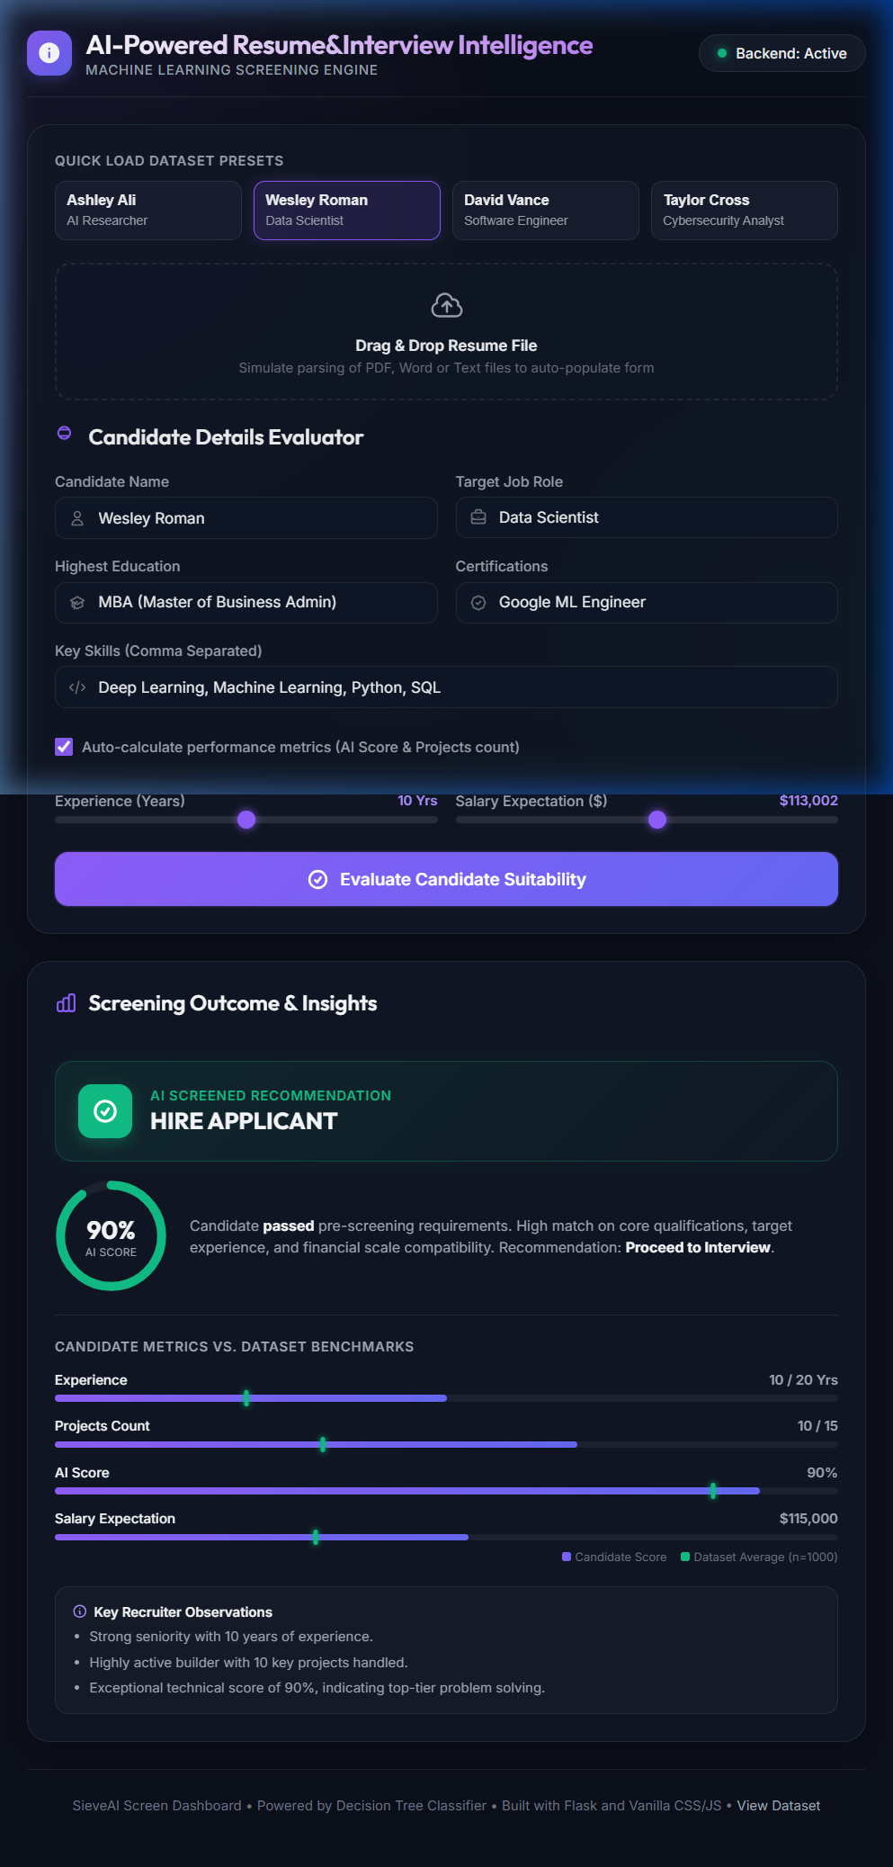
Project Conclusions & Outcomes
Automates recruitment screening and reduces manual effort
Delivers consistent, data-driven recommendations
Improves efficiency and supports evidence-based hiring
Requires careful validation to ensure fairness and generalization

Slide 10
Thank You.
AI-Powered Resume & Interview Intelligence Platform.

